Slide 1
installing third-party packages, managing environments, and Pandas.
Week 12 | Lecture 1 (12.1)

Slide 2
This Week’s Content
Lecture 12.1
Installing third-party packages, managing environments, and Pandas.
Reading: Chapter 12
Lecture 12.2
More Pandas, NumPy, Matplotlib/Seaborn.
Reading: Chapter 12
Lecture 12.3
Design Problem: Stock Market – Part 1

Slide 3

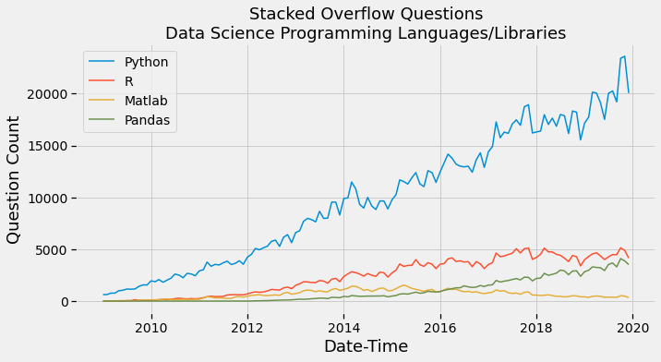
Why Python?
High-level language making it more like a readable, human language than other low-level languages.
Simple and clear syntax.
Large open-source community.
Used by Google, Firefox, Dropbox, Youtube, Instagram, Yelp, NASA, CIA, etc.
The Artificial Intelligence (AI) community overwhelmingly uses Python.

Slide 4









Why Python?
High-level language making it more like a readable, human language than other low-level languages.
Simple and clear syntax.
Large open-source community.
Used by Google, Firefox, Dropbox, Youtube, Instagram, Yelp, NASA, CIA, etc.
The Artificial Intelligence (AI) community overwhelmingly uses Python.

Slide 5






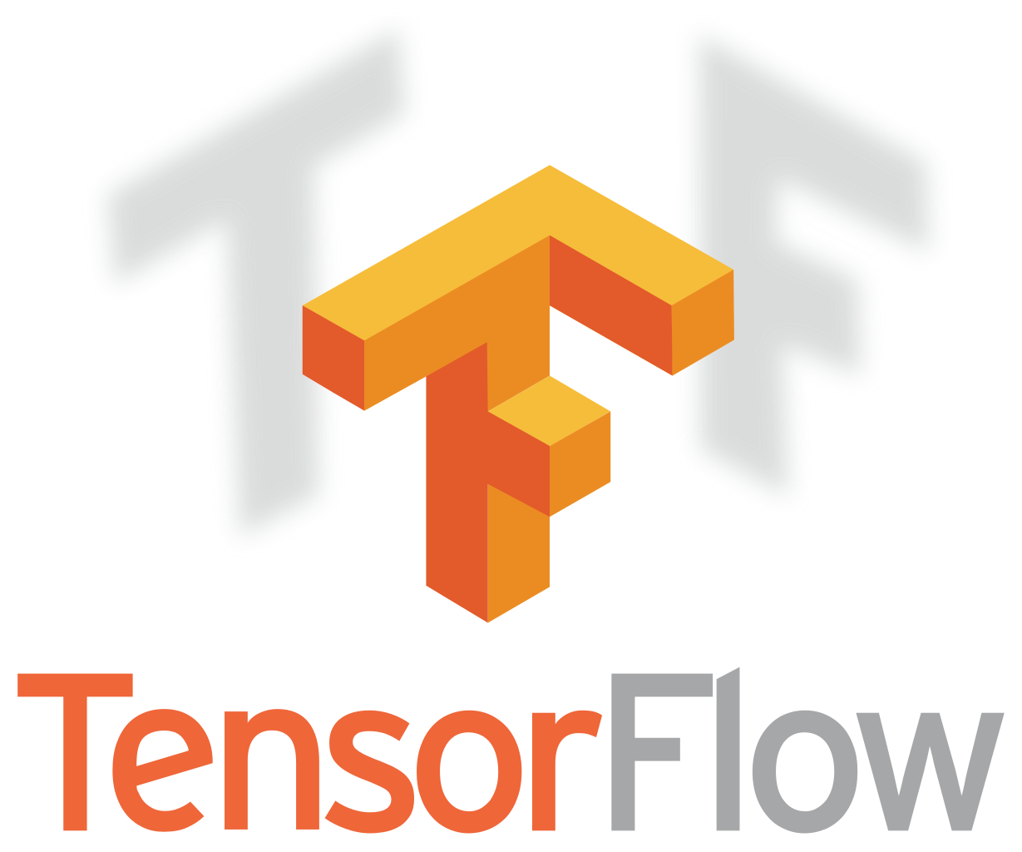


Why Python?
High-level language making it more like a readable, human language than other low-level languages.
Simple and clear syntax.
Large open-source community.
Used by Google, Firefox, Dropbox, Youtube, Instagram, Yelp, NASA, CIA, etc.
The Artificial Intelligence (AI) community overwhelmingly uses Python.

Slide 6
Why Python?
High-level language making it more like a readable, human language than other low-level languages.
Simple and clear syntax.
Large open-source community.
Used by Google, Firefox, Dropbox, Youtube, Instagram, Yelp, NASA, CIA, etc.
The Artificial Intelligence (AI) community overwhelmingly uses Python.

Slide 7
Third-Party Packages.
Up to this point in APS106, we have used libraries that come pre-installed with Python including math, random, turtle, etc.
Now we will introduce you to third-party packages.
These are some common packages/libraries, and we will cover those highlighted in blue.
Package/Library | Common Alias | Description
numpy | np | NumPy includes functions and classes that aid in numerical computation. NumPy is used in many other data science packages.
pandas | pd | pandas provides methods and classes for tabular and time-series data.
sklearn | sk | scikit-learn provides implementations of many machine learning algorithms with a uniform syntax for preprocessing data, specifying models, fitting models with cross-validation, and assessing models.
matplotlib.pyplot | plt | Matplotlib allows the creation of data visualizations in Python. The functions mostly expect NumPy arrays.
seaborn | sns | seaborn also allows the creation of data visualizations but works better with pandas DataFrame objects.
scipy | sp | SciPy provides algorithms and functions for computing problems that arise in science, engineering and statistics.
statsmodels | sm | statsmodels adds functionality to Python to estimate many different kinds of statistical models, make inferences from those models, and explore data.

Slide 8

Anaconda.
PyPi
(Python Package
Index)
NumPy
PyPi and Anaconda are two popular package distribution options.
PyPi has more packages than Anaconda, however, all the most popular scientific, data science, machine learning, AI, etc. packages are on Anaconda.
Anaconda generally does a better job of managing dependencies.
Anaconda can also manage Python installations and virtual environments, which PyPi cannot, because its just a package index.
Pandas
Matplotlib
Seaborn
Anaconda
(Anaconda Package
Index)
NumPy
Pandas
Seaborn
Matplotlib

Slide 9
Anaconda.
NumPy
Operating System
pip install
pip install numpy
pip install seaborn
Anaconda Environment
APS106-winter-2024
CIV100-winter-2024
Python Version
3.10
3.10
Packages
numpy-1
pandas-1
seaborn-1
matplotlib-1
numpy-1
pandas-2
seaborn-2
matplotlib-1
Pandas
Matplotlib
Seaborn
NumPy
Pandas
Seaborn
conda install
conda install pandas
conda install matplotlib
Matplotlib

Slide 10
Anaconda.
PyPi
(Python Package
Index)
NumPy
Operating System
Anaconda Environment
Python Version
Packages
Pandas
Matplotlib
Seaborn
Anaconda
NumPy
Pandas
Seaborn
Matplotlib

Slide 11
Anaconda.
NumPy
Operating System
Operating System
Anaconda Environment
APS106-winter-2024
Python Version
3.10
Packages
numpy-1
pandas-1
seaborn-1
matplotlib-1
Pandas
Matplotlib
Seaborn
NumPy
Pandas
conda install
conda install numpy
conda install pandas
conda install seaborn
conda install matplotlib
Seaborn
Matplotlib

Slide 12
Anaconda.
NumPy
Operating System
Anaconda Environment
APS106-winter-2024
CIV100-winter-2024
my-cool-website
Python Version
3.10
3.10
3.11
Packages
numpy-1
pandas-1
seaborn-1
matplotlib-1
numpy-1
pandas-2
seaborn-2
matplotlib-1
pandas-5
seaborn-4
Pandas
Matplotlib
Seaborn
NumPy
Pandas
pip install
pip install pandas
pip install seaborn
Seaborn
Matplotlib

Slide 13
Anaconda.
Operating System
Ideally, you should try to use either pip or conda for installing your packages.
This is not always possible if a package you need is only available on PyPi.
Anaconda Environment
APS106-winter-2024
CIV100-winter-2024
my-cool-website
Python Version
3.10
3.10
3.11
Packages
numpy-1
pandas-1
seaborn-1
matplotlib-1
numpy-1
pandas-2
seaborn-2
matplotlib-1
pandas-5
seaborn-4

Slide 14
Operating System
Anaconda Environment
APS106-winter-2024
CIV100-winter-2024
my-cool-website
Python Version
3.10
3.10
3.11
Packages
numpy-1
pandas-1
seaborn-1
matplotlib-1
numpy-1
pandas-2
seaborn-2
matplotlib-1
pandas-5
seaborn-4

Slide 15
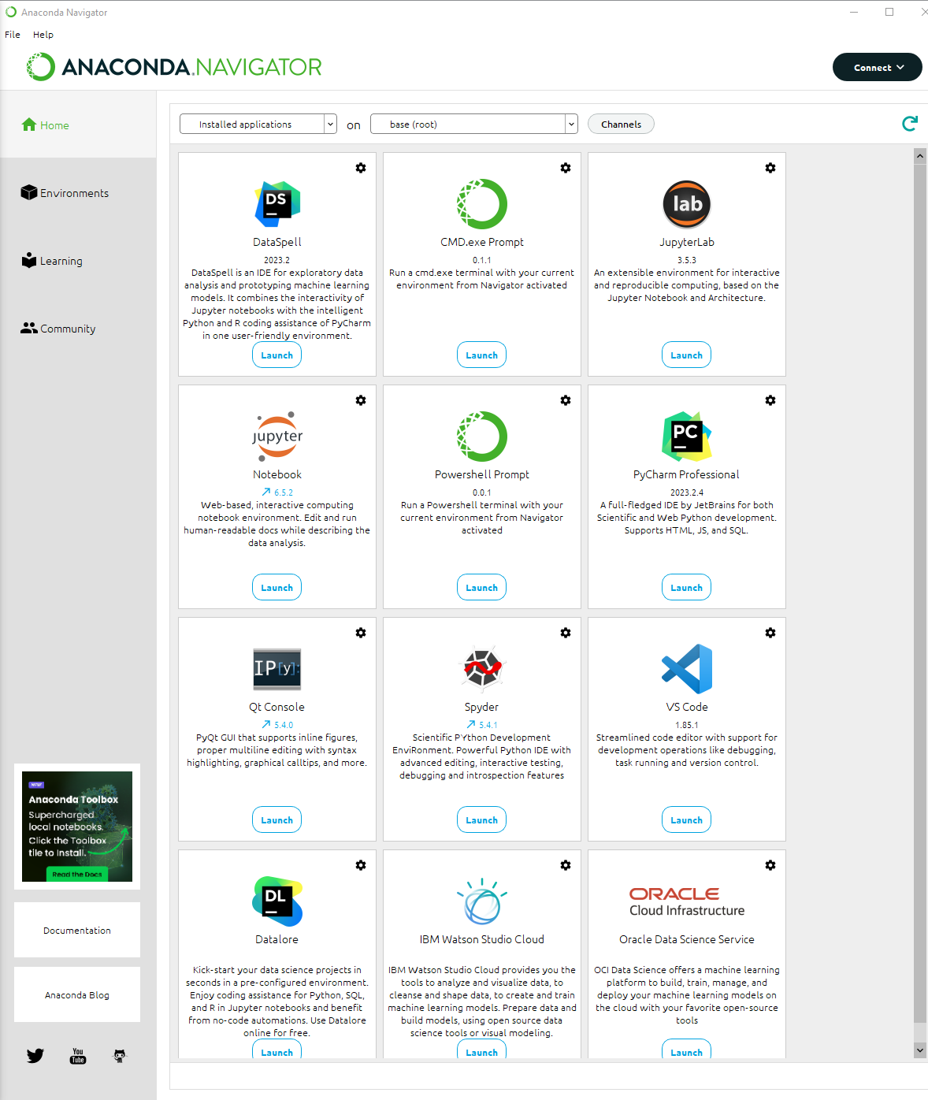
Programming Tools.
Launch and install and update programming tools in Anaconda Navigator.
Integrated Development Environments (IDE).
Notebooks.
Consoles.

Slide 16
Programming Tools.
Launch and install and update programming tools in Anaconda Navigator.
Integrated Development Environments (IDE).
Notebooks.
Consoles.

Slide 17
Programming Tools.
Launch and install and update programming tools in Anaconda Navigator.
Integrated Development Environments (IDE).
Notebooks.
Consoles.

Slide 18
Programming Tools.
Launch and install and update programming tools in Anaconda Navigator.
Integrated Development Environments (IDE).
Notebooks.
Consoles.

Slide 19
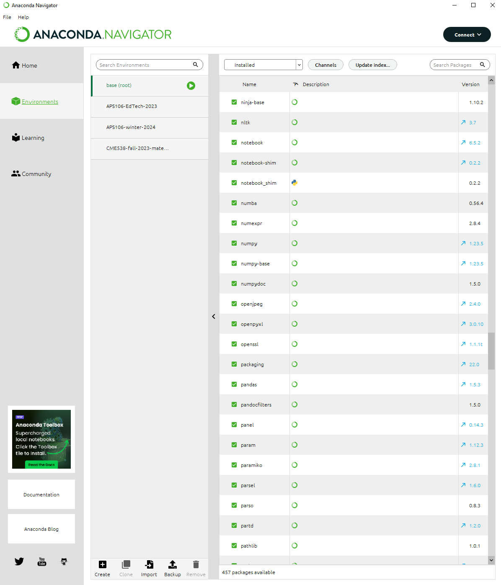
Environments.
These are environments.

Slide 20
Environments.
This environment (base) comes pre-installed with Anaconda and has all the most popular scientific packages installed.

Slide 21
Environments.
These are environments I created.
To create an environment, you can press this button.

Slide 22
Packages.
These are all the packages installed in the (base) environment.

Slide 23
Packages.
This package was install the PyPi package index.
This package was install the Anaconda package index.
I can see the version of this package here.

Slide 24
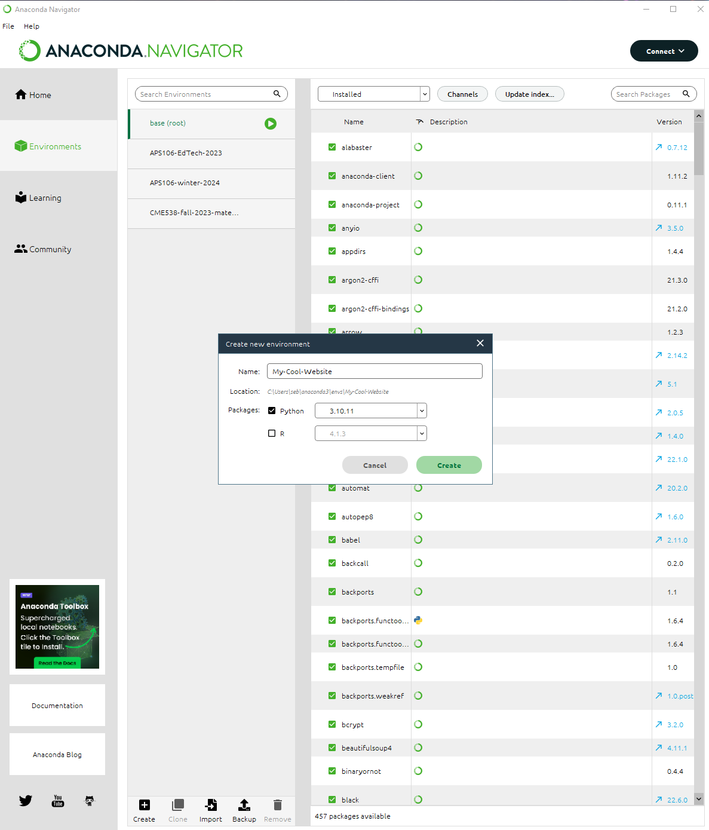
Create An Environment.
Let’s crate a new environment for our new cool website project.
By creating an environment for this project, it will guarantee that our code always works and that our collaborators can always reproduce the environment.
Let’s choose to use Python version 3.10 for this environment.
Choose a name for your environment so it can be easily identified.

Slide 25
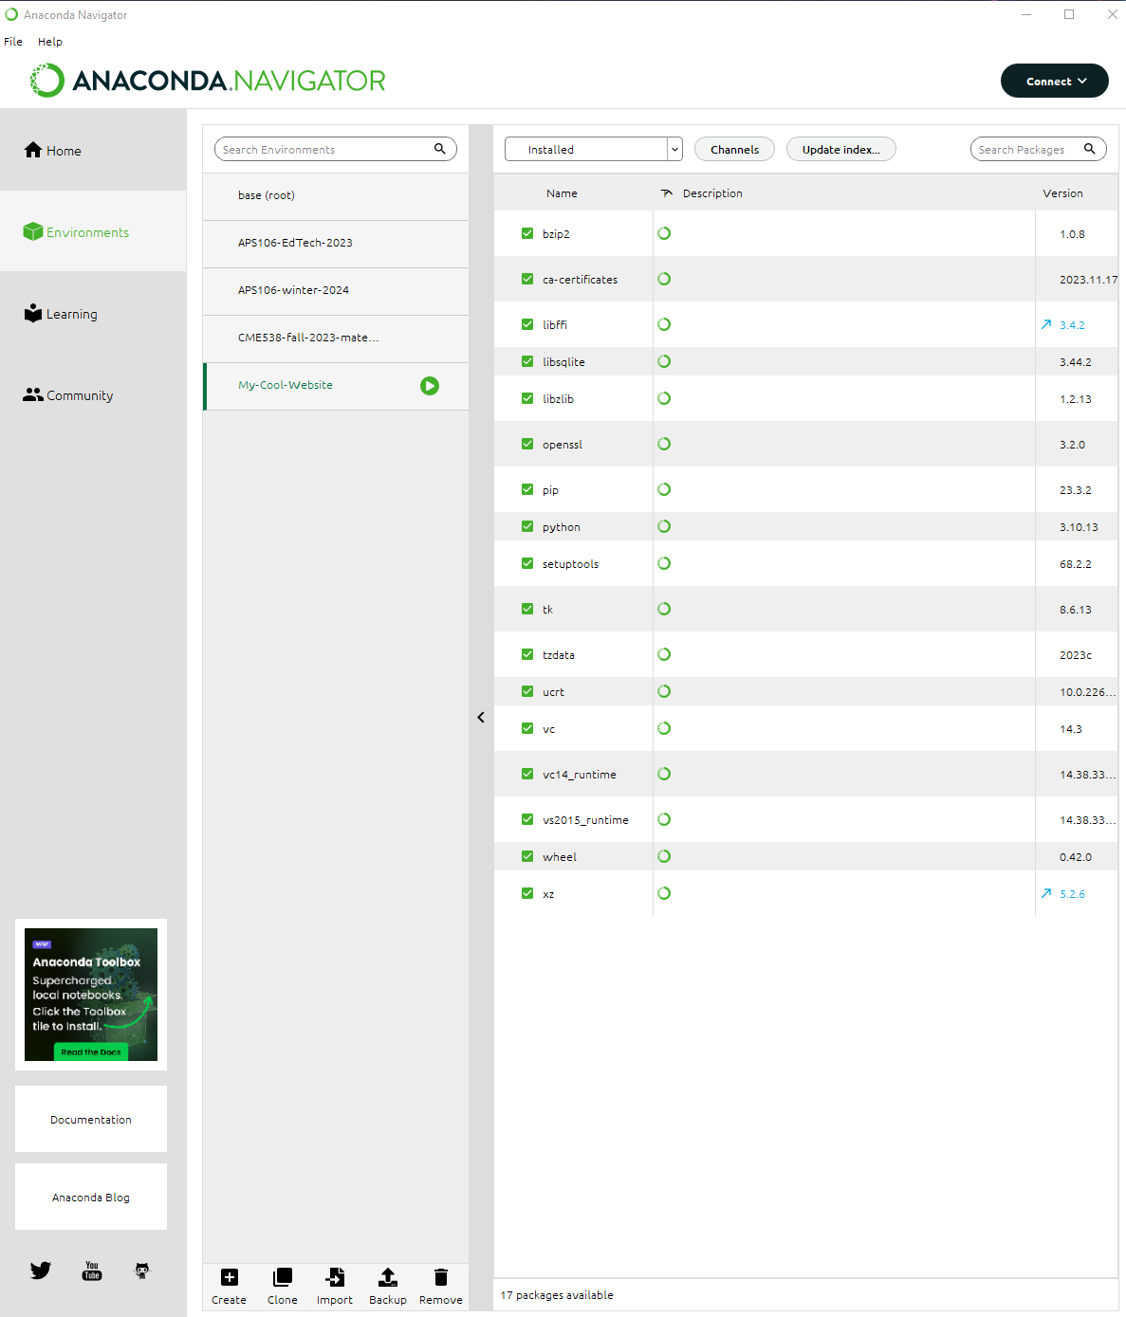
Installed Packages.
When you create a new environment, it is mostly empty except for a few default packages.
For example, you can see the pip package is installed, which allows us to us pip install to install other 3rd party packages.
We can also see that Python version 3.10 is installed.

Slide 26

Launch Apps.
We can launch applications from an environment by clicking the green play button.
As you can see, we can launch a terminal but not a Jupyter Notebook (its grayed out).
This is because we have not installed Jupyter for our new environment yet.

Slide 27
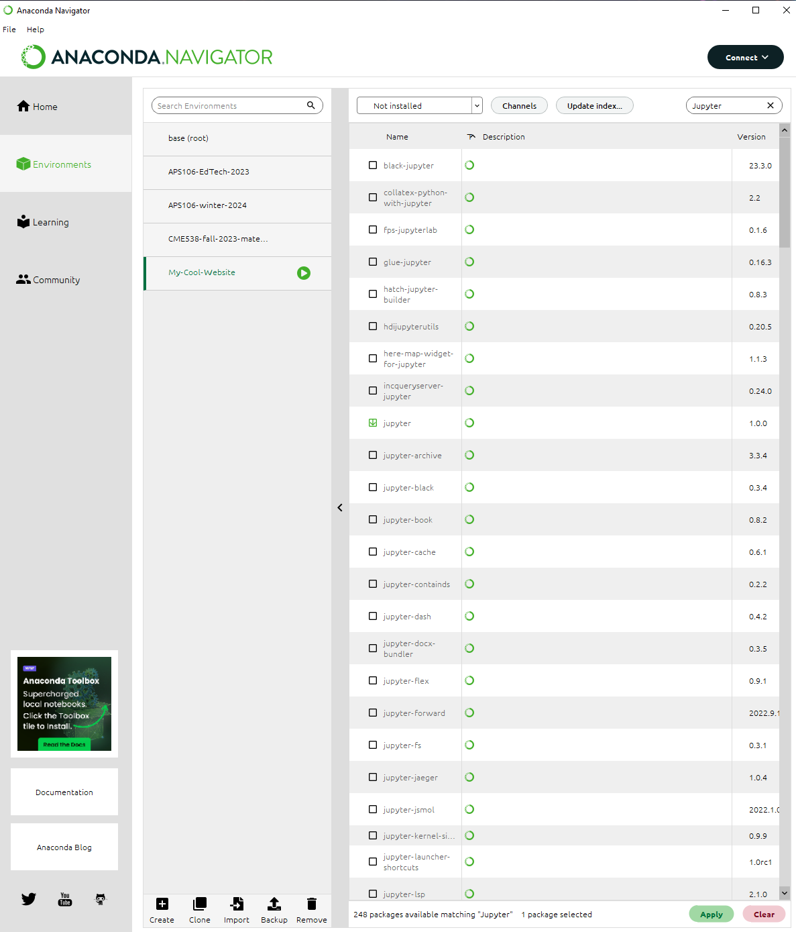
Install A Package.
To install Jupyter, we filter to see all packages that are not installed.
Then select the Jupyter package.
And click Apply to install.

Slide 28
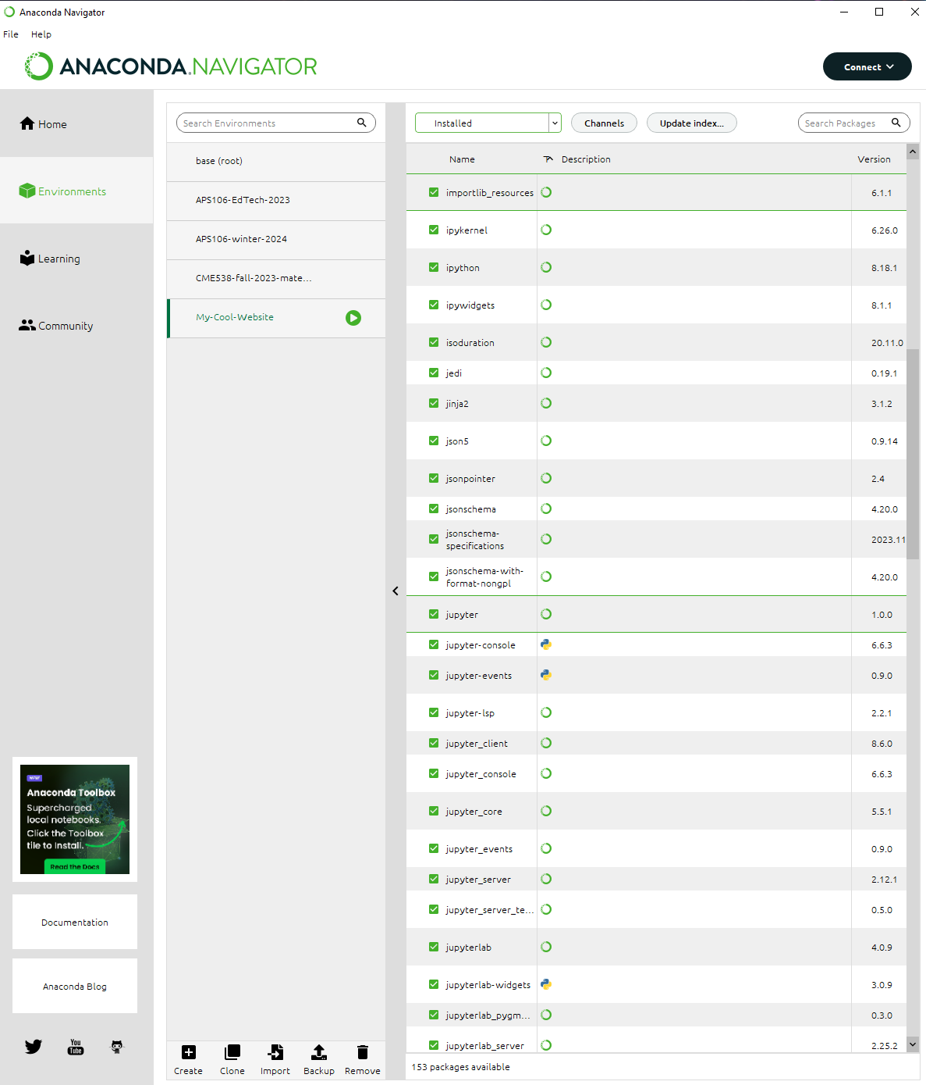
Install A Package.
Now, if we filter by packages that are installed in our My-Cool-Website environment, we can see that Jupyter is installed.

Slide 29
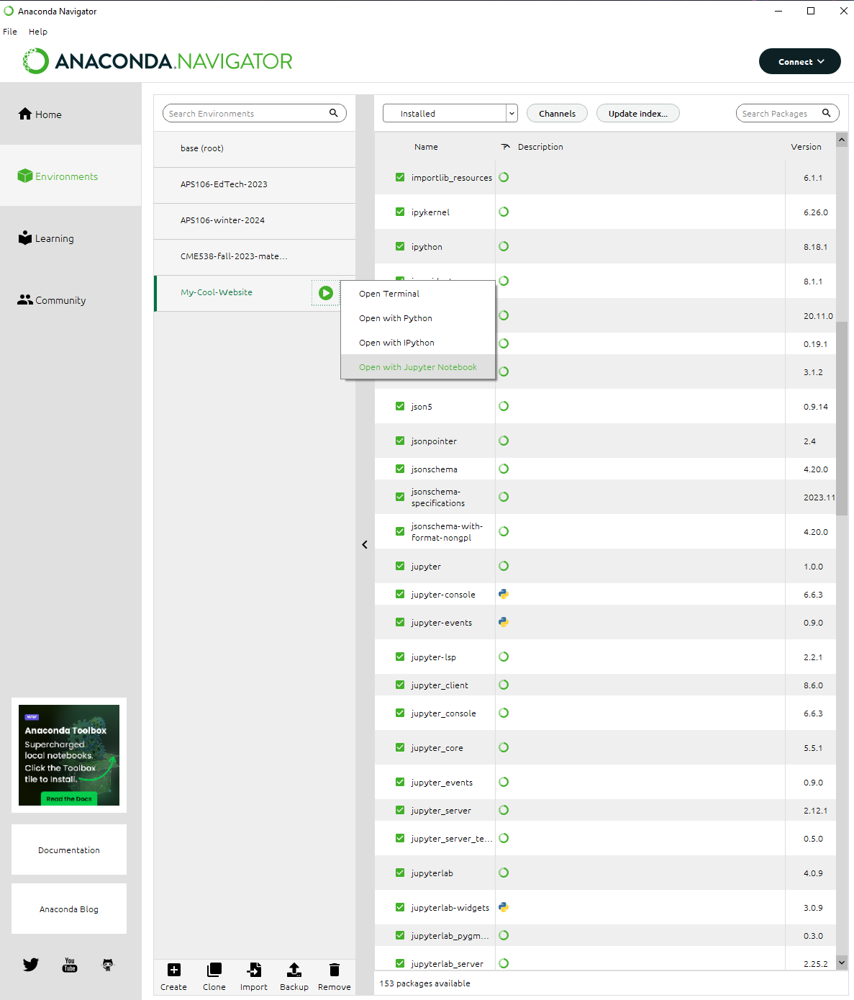
Launch Jupyter.
And now, we can launch a Jupyter Notebook that will be running in the My-Cool-Website environment.

Slide 30
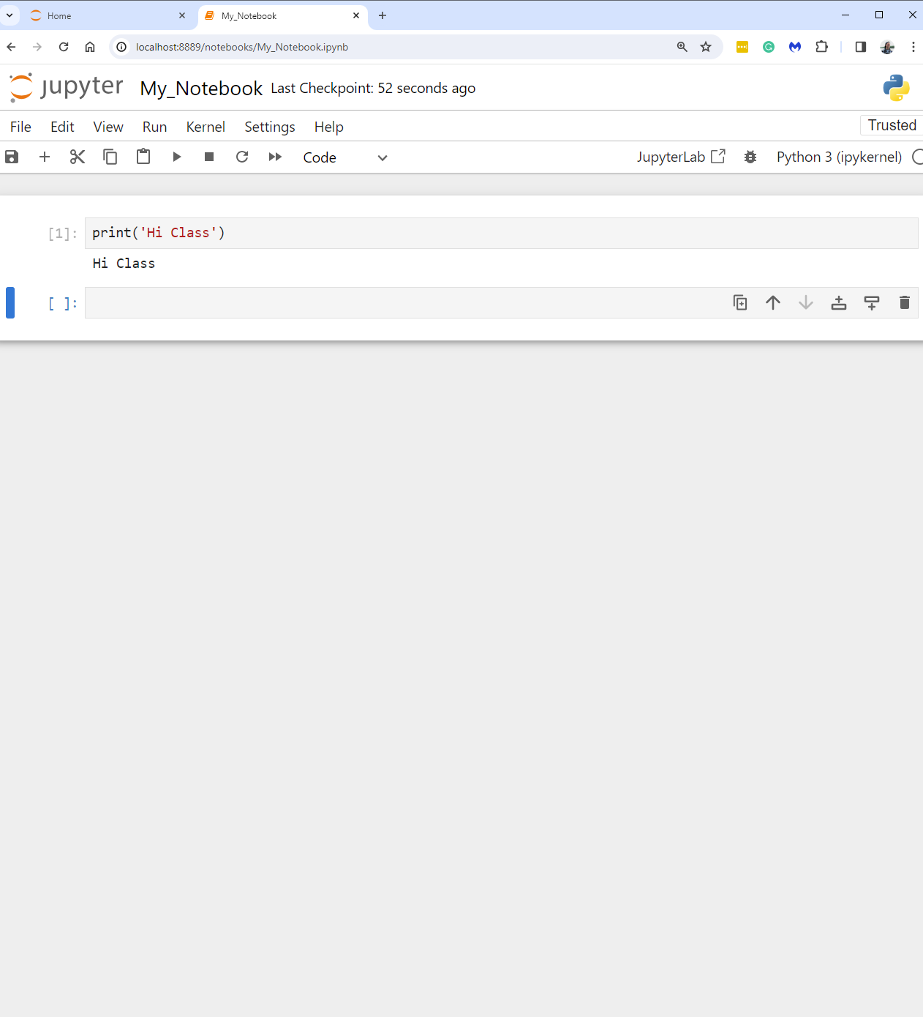
Launch Jupyter.
This Notebook will be running Python version 3.10 and will have access to all packages that are installed in the My-Cool-Website environment.

Slide 31

Launch Other Apps.
You can launch any app using an anaconda environment of your choosing.
First, select the environment you want to use.
Then, launch the app.

Slide 32
Installing Packages.
From a Jupyter Notebook
Quick and dirty.
Not recommended.
From a Terminal
Ideal but not beginner friendly.
From Anaconda Navigator
A good starting place for beginners.

Slide 33
Installing Packages.
From a Jupyter Notebook
Quick and dirty.
Not recommended.
From a Terminal
Ideal but not beginner friendly.
From Anaconda Navigator
A good starting place for beginners.
Open your notebook
Click Link:
1. Installing Packages From A Jupyter Notebook

Slide 34
Installing Packages.
From a Jupyter Notebook
Quick and dirty.
Not recommended.
From a Terminal
Ideal but not beginner friendly.
From Anaconda Navigator
A good starting place for beginners.
Open your anaconda navigator
Click Link:
Installing Packages From terminal and navigator

Slide 35
CSV reader to Pandas
Sort, group, etc. lots of code to write.

Slide 36

Pandas.
What is Pandas?

Slide 37
Pandas.
What is Pandas?
These are Pandas.

Slide 38
Pandas.
What else is Pandas?
A fast, powerful, flexible and easy to use open-source data analysis and manipulation tool, built on top of the Python programming language.
Pandas stands for “Python Data Analysis Library”.

Slide 39
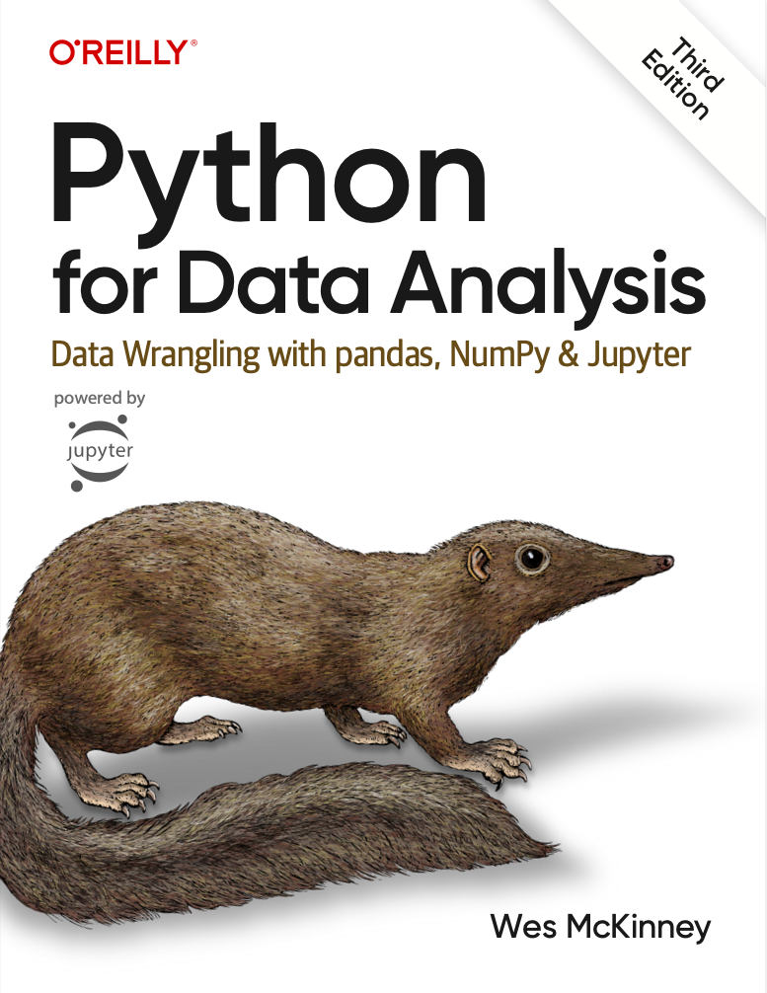
Pandas.
You have free access to a fantastic book by the creator of Pandas!
Click here.
This is not an official course resource but could come in handy beyond APS106.

Slide 40
Pandas.
DataFrames
Pandas Data Structures
Importing Data
Indexing
Utility Methods

Slide 41
Pandas I
DataFrames
Pandas Data Structures
Importing Data
Indexing
Utility Methods

Slide 42
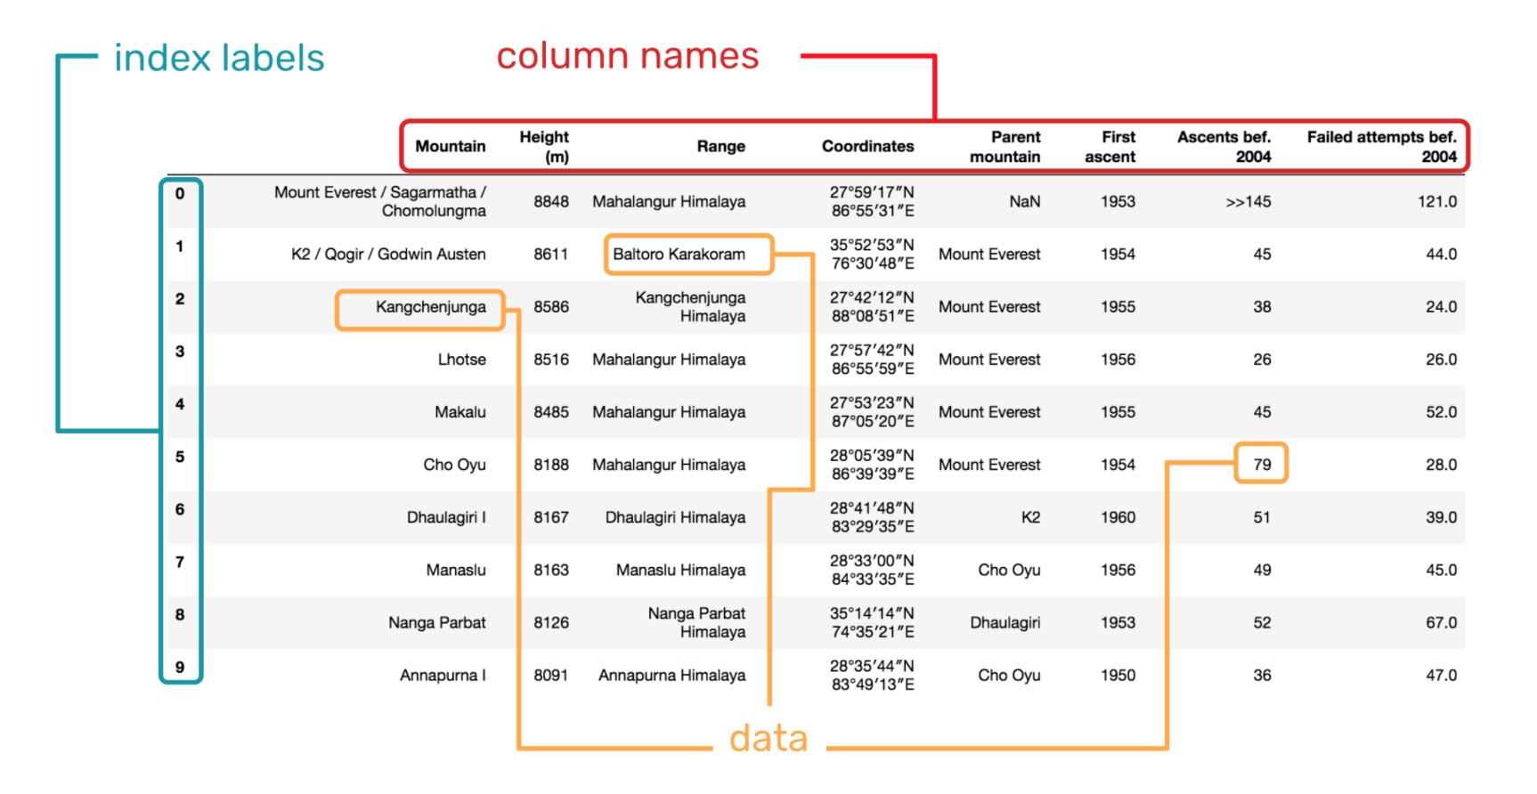
DataFrames
A DataFrame is a 2-dimensional labeled data structure with columns of potentially different types.
Matrix?
You can think of it like a spreadsheet or SQL table.
DataFrames were first introduced in the R Programming Language and are generally the most used Pandas object.
Pandas is the most popular Python package for working with DataFrames.
Dask, Polar, Vaex.

Slide 43
Pandas I
DataFrames
Pandas Data Structures
Importing Data
Indexing
Utility Methods

Slide 44
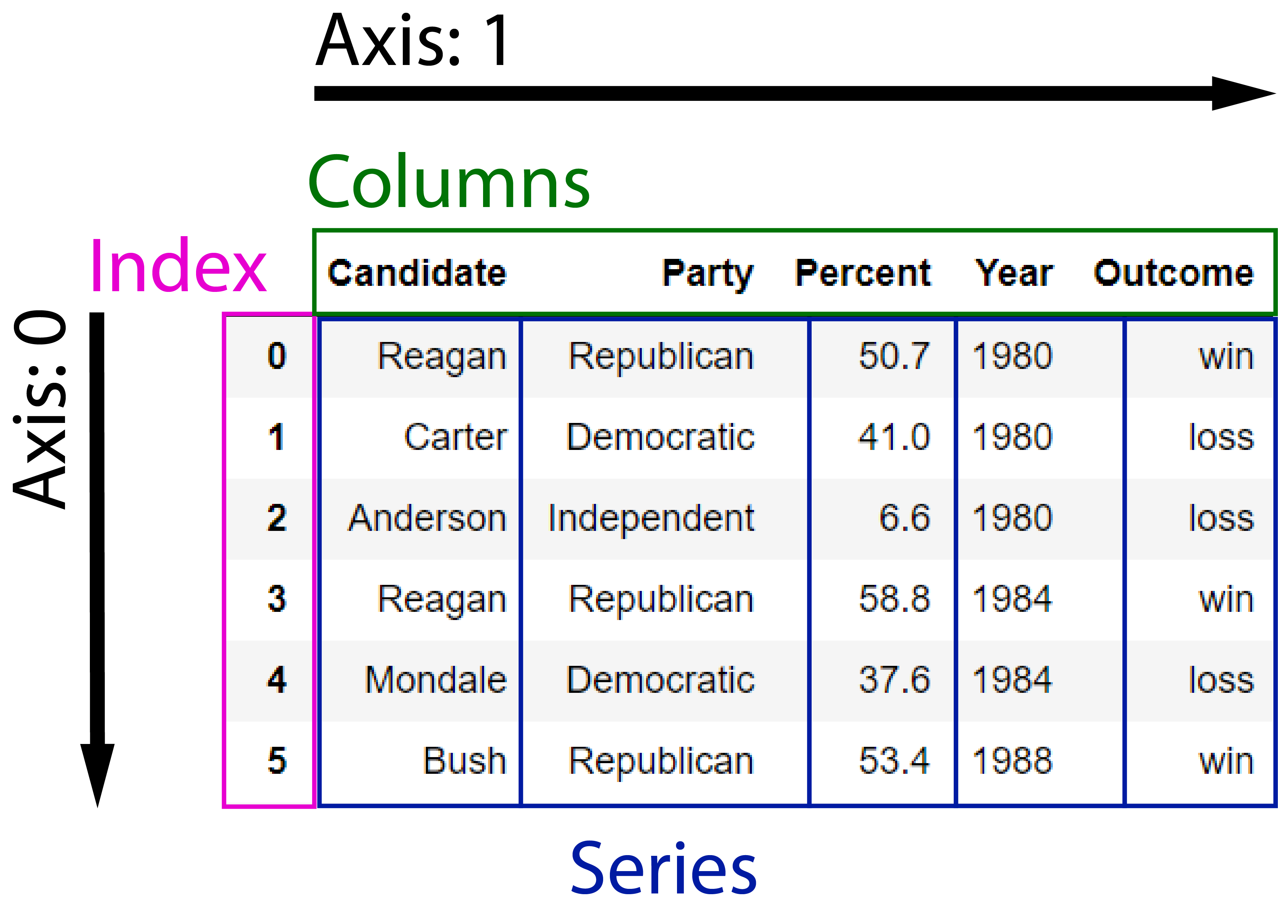
Data Structures
Dataset
U.S. Election Results.
There are three fundamental data structures in pandas:
Data Frame: 2D data tabular data.
Series: 1D data. We can think of Series as columnar data.
Index: A sequence of row labels.

Slide 45
Data Structures
DataFrames
There are three fundamental data structures in pandas:
Data Frame: 2D data tabular data.
Series: 1D data. We can think of Series as columnar data.
Index: A sequence of row labels.

Slide 46
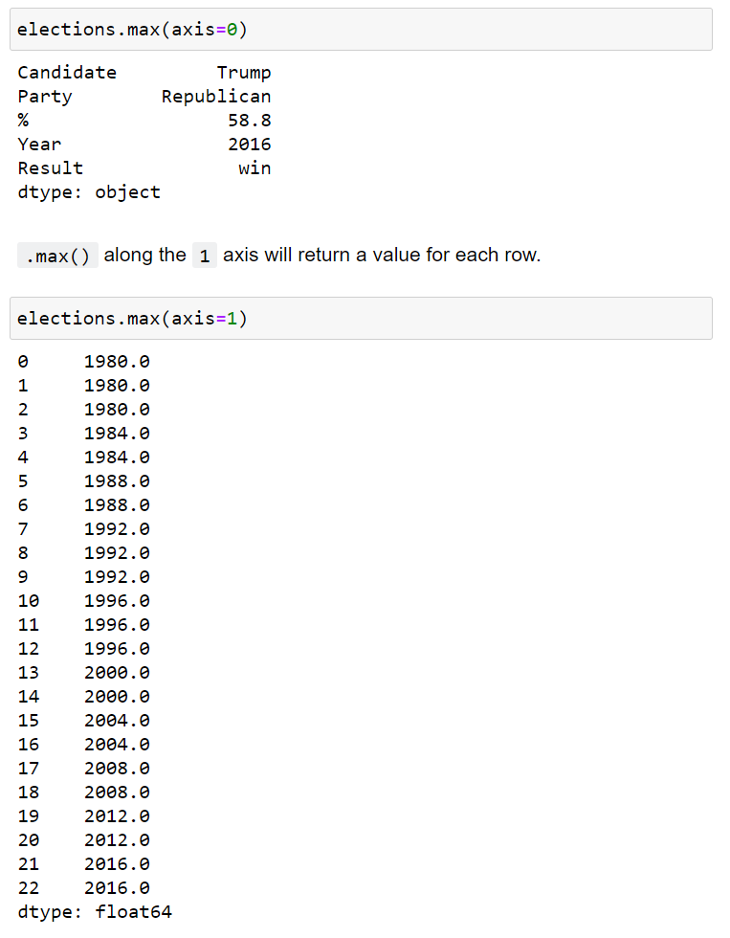
Data Structures
Axis 0
Column-wise
There are three fundamental data structures in pandas:
Data Frame: 2D data tabular data.
Series: 1D data. We can think of Series as columnar data.
Index: A sequence of row labels.
Axis 1
Row-wise

Slide 47
Data Structures
Series
We can think of a Data Frame as a collection of Series that all share the same Index.
There are three fundamental data structures in pandas:
Data Frame: 2D data tabular data.
Series: 1D data. We can think of Series as columnar data.
Index: A sequence of row labels.
Candidate
Series
Party
Series
Percent
Series
Outcome
Series
Year
Series

Slide 48
Data Structures
Series
We can think of a Data Frame as a collection of Series that all share the same Index.
There are three fundamental data structures in pandas:
Data Frame: 2D data tabular data.
Series: 1D data. We can think of Series as columnar data.
Index: A sequence of row labels.
Candidate
Series

Slide 49
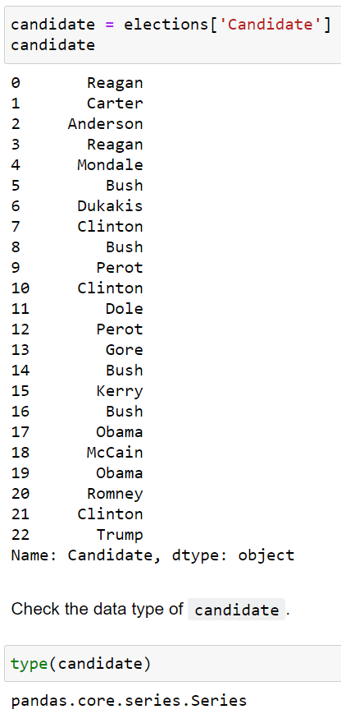
Data Structures
There are three fundamental data structures in pandas:
Data Frame: 2D data tabular data.
Series: 1D data. We can think of Series as columnar data.
Index: A sequence of row labels.

Slide 50
Data Structures
Index
There are three fundamental data structures in pandas:
Data Frame: 2D data tabular data.
Series: 1D data. We can think of Series as columnar data.
Index: A sequence of row labels.
Index

Slide 51
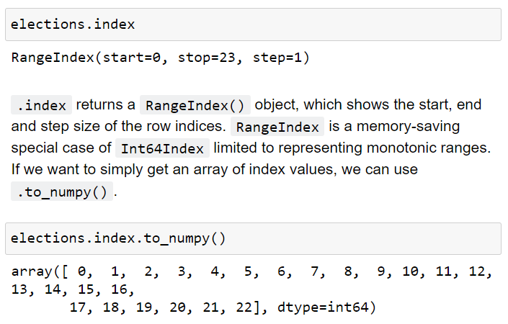
Data Structures
There are three fundamental data structures in pandas:
Data Frame: 2D data tabular data.
Series: 1D data. We can think of Series as columnar data.
Index: A sequence of row labels.

Slide 52
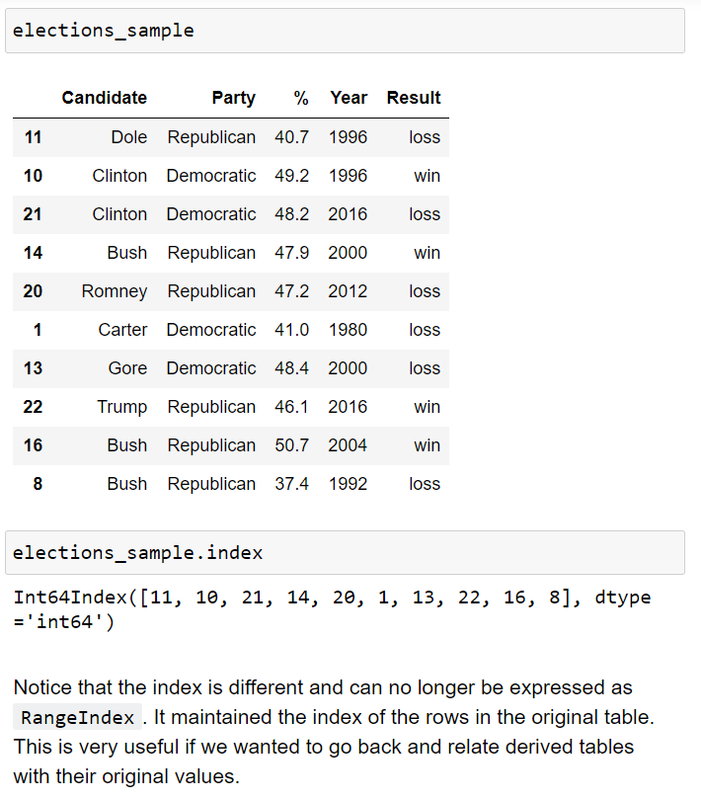
Data Structures
There are three fundamental data structures in pandas:
Data Frame: 2D data tabular data.
Series: 1D data. We can think of Series as columnar data.
Index: A sequence of row labels.

Slide 53
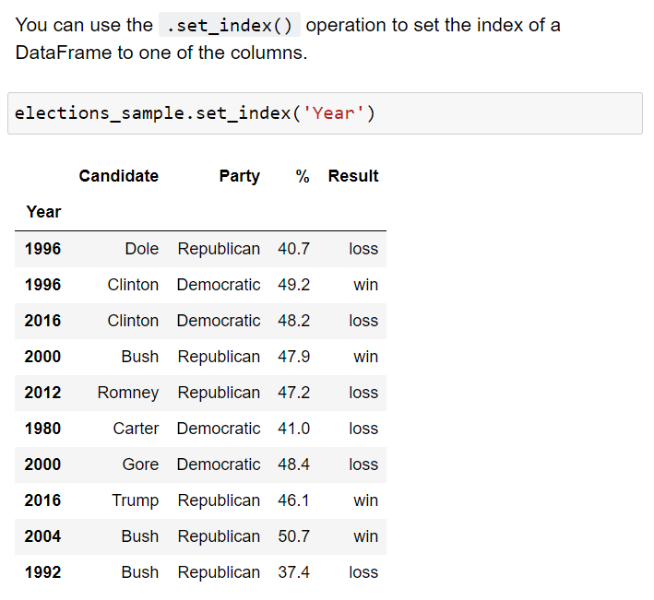
Data Structures
There are three fundamental data structures in pandas:
Data Frame: 2D data tabular data.
Series: 1D data. We can think of Series as columnar data.
Index: A sequence of row labels.
Indices (row labels) can also:
be non-numeric
have a name (e.g. “Year”).

Slide 54
Data Structures
There are three fundamental data structures in pandas:
Data Frame: 2D data tabular data.
Series: 1D data. We can think of Series as columnar data.
Index: A sequence of row labels.
Indices (row labels) do not have to be unique.

Slide 55
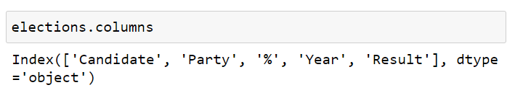
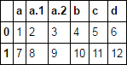
Data Structures
There are three fundamental data structures in pandas:
Data Frame: 2D data tabular data.
Series: 1D data. We can think of Series as columnar data.
Index: A sequence of row labels.
Columns (Series names).
Column names in Pandas are almost always unique!
You really shouldn’t have two columns named “Candidate”.

Slide 56
Pandas I
DataFrames
Pandas Data Structures
Importing Data
Indexing
Utility Methods

Slide 57
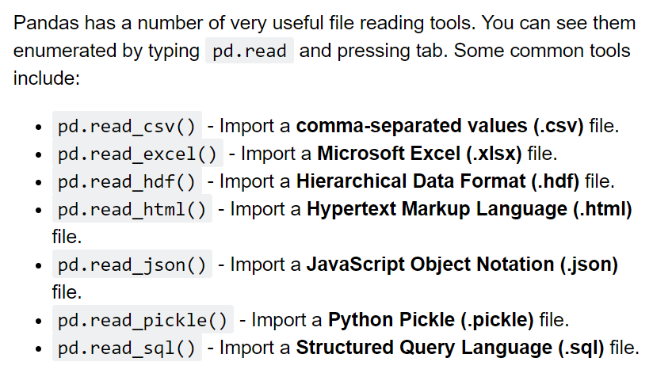
Importing Data
Pandas has a number of useful functions for importing data from common formats.

Slide 58
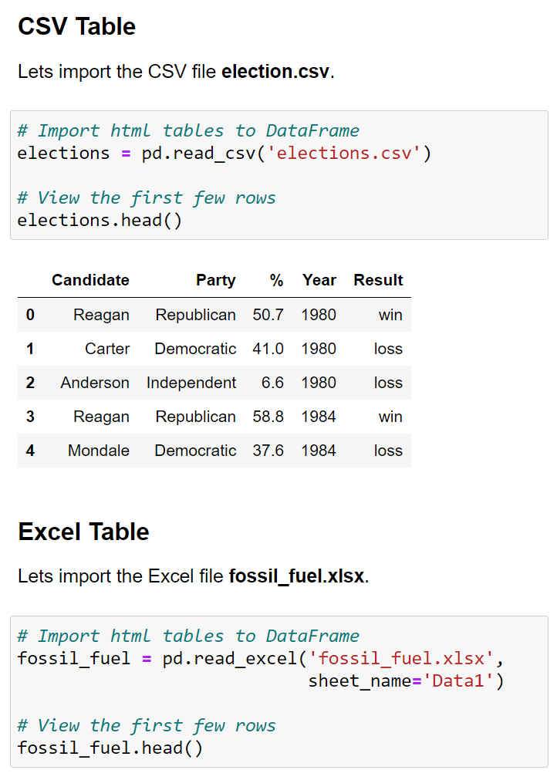
Importing Data
Pandas has a number of useful functions for importing data from common formats.
To get a quick look at the first 5 rows of a DataFrame, use the .head() method.

Slide 59
Pandas I
DataFrames
Pandas Data Structures
Importing Data
Indexing
Utility Methods

Slide 60
Indexing
There are many ways to access rows and columns of a Pandas DataFrame.
We will spend some time reviewing the most used options.
[]
.loc[]
Boolean Array Selection
.iloc[]

Slide 61
Indexing
There are many ways to access rows and columns of a Pandas DataFrame.
We will spend some time reviewing the most used options.
[]
.loc[]
Boolean Array Selection
.iloc[]

Slide 62
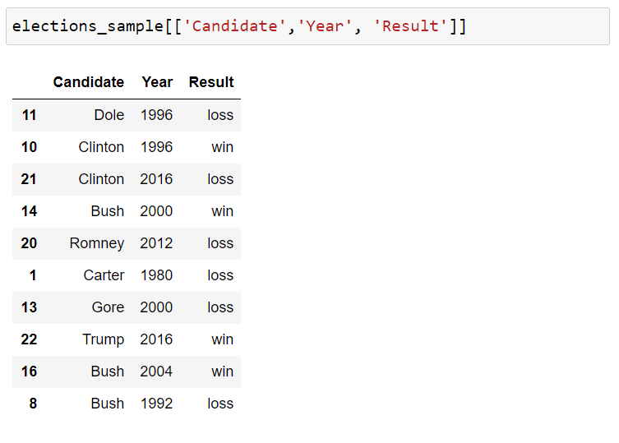
Indexing - [] Operator
You can access columns using the square [ ] brackets.
You can pass a list of column names to select only those columns.

Slide 63
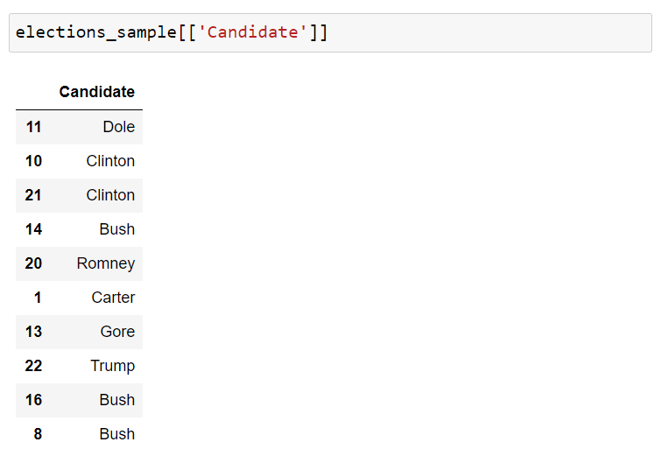
Indexing - [] Operator
You can access columns using the square [ ] brackets.
If you pass a list with a single element you get back a DataFrame.

Slide 64
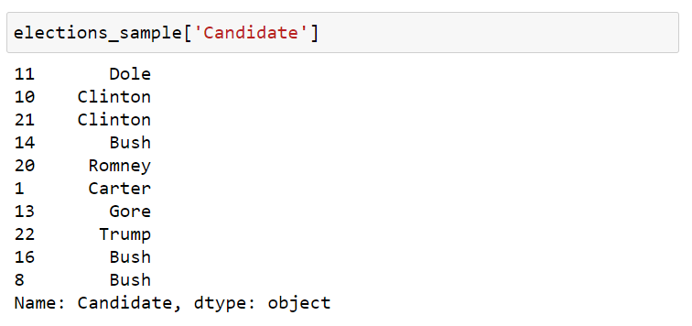
Indexing - [] Operator
You can access columns using the square [ ] brackets.
If you pass single column name string, you get back a Series.

Slide 65
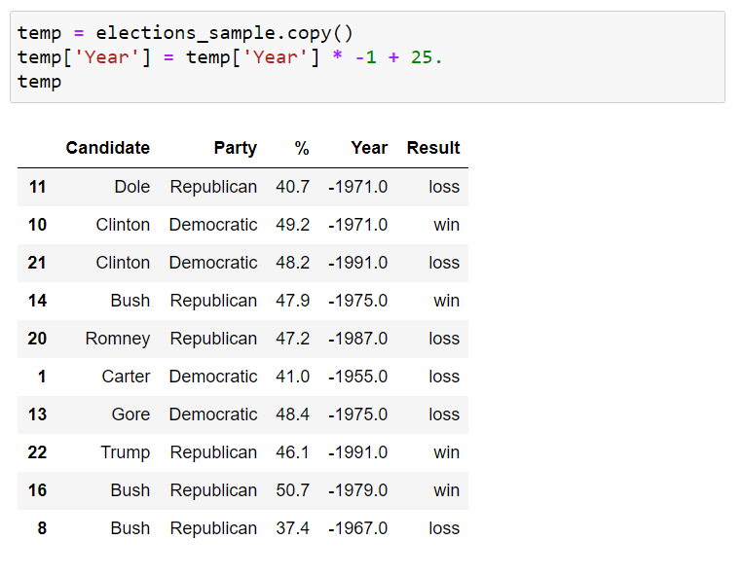
Indexing - [] Operator
You can access columns using the square [ ] brackets.
You can modify and even add columns using the square brackets [ ].

Slide 66
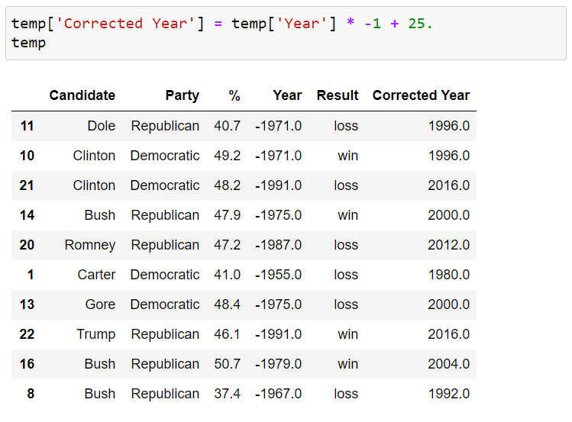
Indexing - [] Operator
You can access columns using the square [ ] brackets.
We can add a new column by assignment.

Slide 67
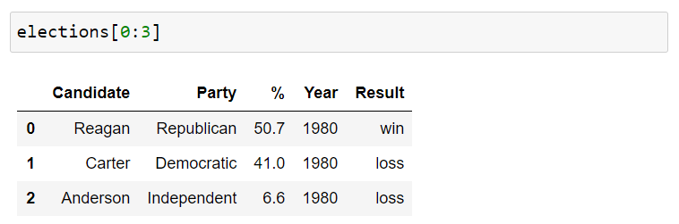
Indexing - [] Operator
You can access columns using the square [ ] brackets.
We can also index by row numbers using the [] operator.
This is called a numeric slice.

Slide 68
Indexing - [] Operator
You can access columns using the square [ ] brackets.
Note:
elections[0] will not work unless the elections DataFrame has a column whose name is the numeric zero.
It is possible for columns to have names that are non-String types, e.g. numeric, datetime etc.

Slide 69
Indexing
There are many ways to access rows and columns of a Pandas DataFrame.
We will spend some time reviewing the most used options.
[]
.loc[]
Boolean Array Selection
.iloc[]

Slide 70
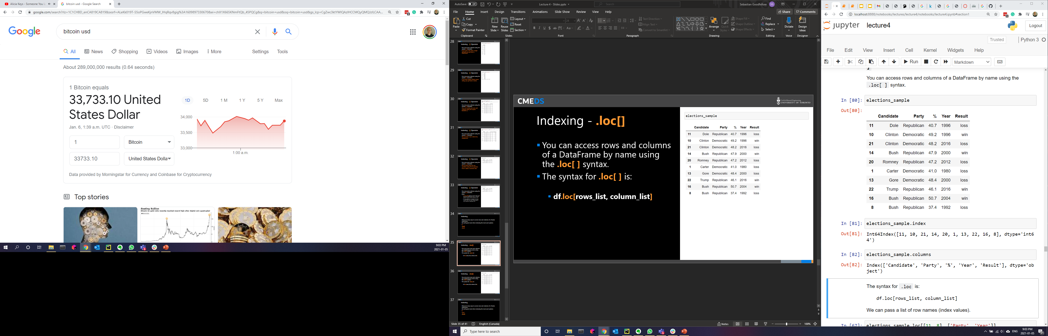
Indexing - .loc[]
You can access rows and columns of a DataFrame by name using the .loc[ ] syntax.
The syntax for .loc[ ] is:
df.loc[rows_list, column_list]

Slide 71
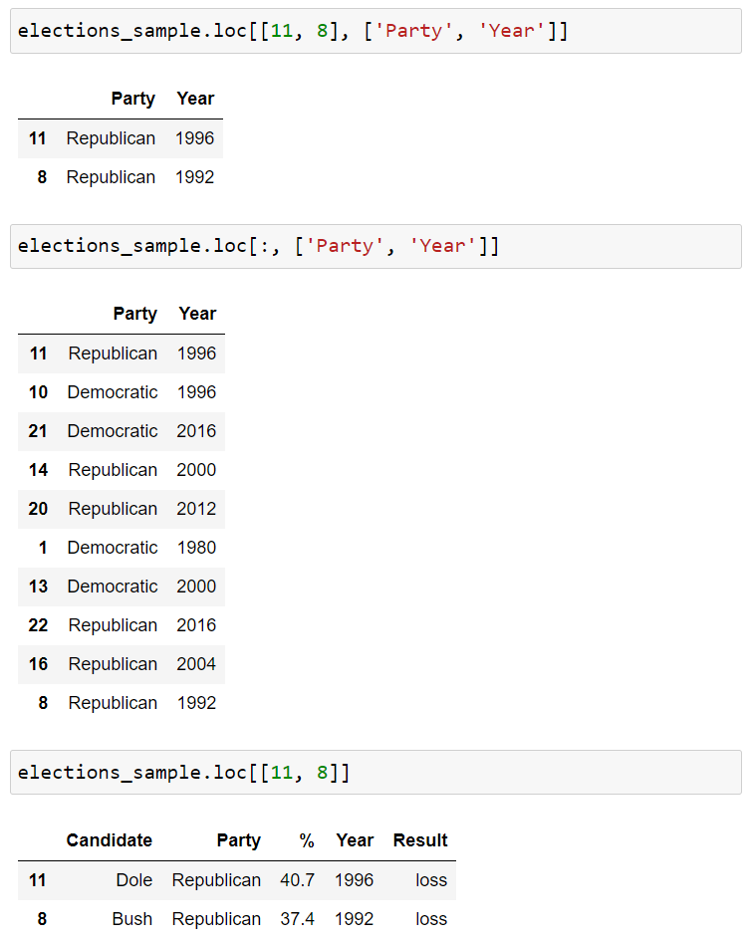
Indexing - .loc[]
You can access rows and columns of a DataFrame by name using the .loc[ ] syntax.
The syntax for .loc[ ] is:
df.loc[rows_list, column_list]

Slide 72
Indexing - .loc[]
You can access rows and columns of a DataFrame by name using the .loc[ ] syntax.
The syntax for .loc[ ] is:
df.loc[rows_list, column_list]
Range Slicing [0:10] works with .loc[] but only when the index is monotonic increasing or decreasing.
Will it work for elections_sample?

Slide 73
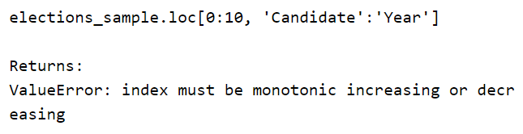
Indexing - .loc[]
You can access rows and columns of a DataFrame by name using the .loc[ ] syntax.
The syntax for .loc[ ] is:
df.loc[rows_list, column_list]
Range Slicing [0:10] works with .loc[] but only when the index is monotonic increasing or decreasing.
Will it work for elections_sample?

Slide 74

Indexing - .loc[]
You can access rows and columns of a DataFrame by name using the .loc[ ] syntax.
The syntax for .loc[ ] is:
df.loc[rows_list, column_list]
If you give .loc[] single scalar arguments for the requested rows and columns, you get back just a single value.

Slide 75
Indexing
There are many ways to access rows and columns of a Pandas DataFrame.
We will spend some time reviewing the most used options.
[]
.loc[]
Boolean Array Selection
.iloc[]

Slide 76

Indexing – Boolean Array Selection
[ ] and .loc[ ] support arrays of Booleans as an input.
In this case, the array must be exactly as long as the number of rows or columns.
The result is a filtered version of the DataFrame, where only rows corresponding to True appear.
This functionality is similar to WHERE in SQL.

Slide 77
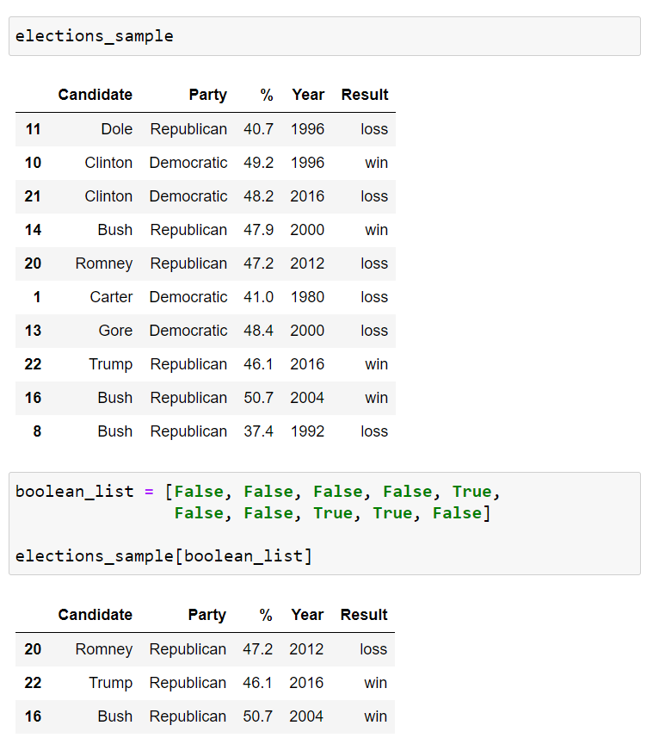
Indexing – Boolean Array Selection
[ ] and .loc[ ] support arrays of Booleans as an input.
In this case, the array must be exactly as long as the number of rows or columns.
The result is a filtered version of the DataFrame, where only rows corresponding to True appear.
This functionality is similar to WHERE in SQL.

Slide 78
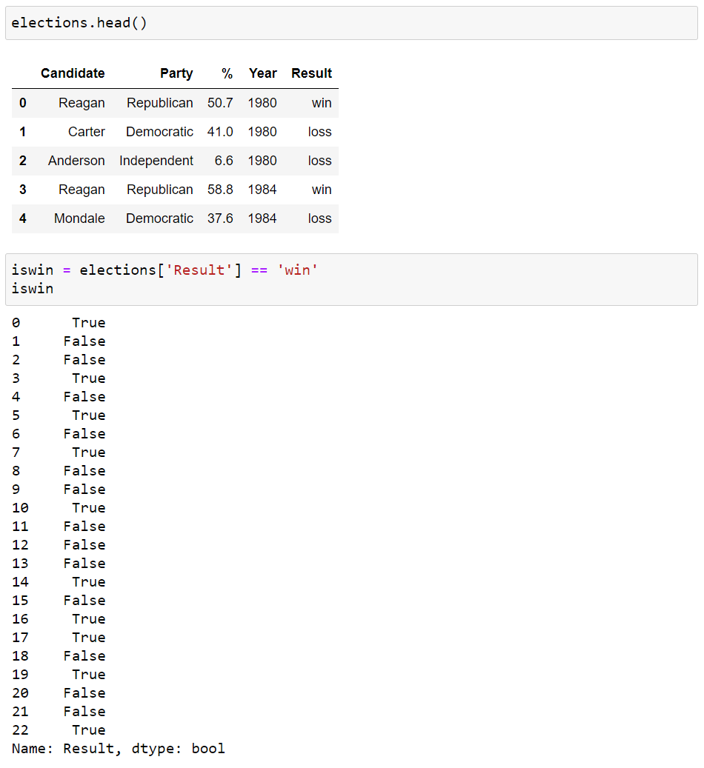
Indexing – Boolean Array Selection
One very common task in Data Science is filtering.
Boolean Array Selection is one way to achieve this in Pandas.
We start by observing logical operators like the equality operator == can be applied to Pandas Series data to generate a Boolean array.
For example, we can compare the Result column to the String ‘win’.

Slide 79
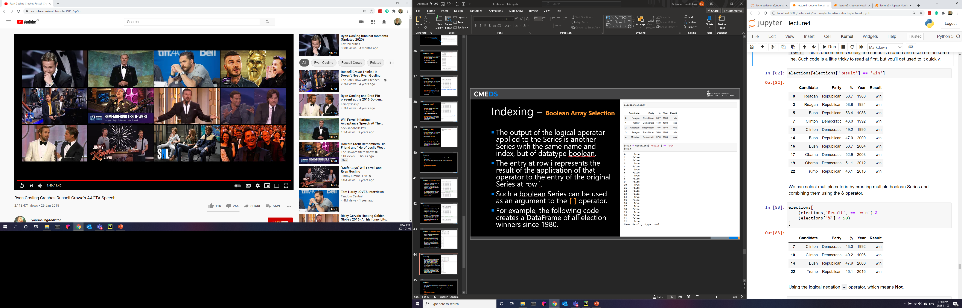
Indexing – Boolean Array Selection
The output of the logical operator applied to the Series is another Series with the same name and index, but of datatype Boolean.
The entry at row i represents the result of the application of that operator to the entry of the original Series at row i.
Such a Boolean Series can be used as an argument to the [ ] operator.

Slide 80
Indexing – Boolean Array Selection
We can select multiple criteria by creating multiple Boolean Series and combining them using the & operator.
Using the logical negation ~ operator, which means Not.
~(elections['%'] < 50)
You can also use the | operator, which mean Or.

Slide 81
Indexing
There are many ways to access rows and columns of a Pandas DataFrame.
We will spend some time reviewing the most used options.
[]
.loc[]
Boolean Array Selection
.iloc[]

Slide 82
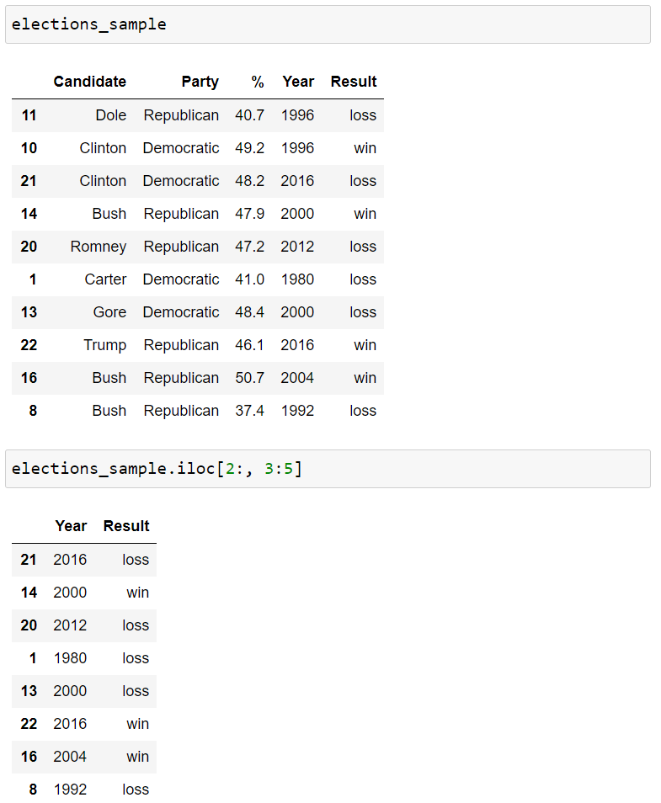
Indexing - .iloc()
0
1
2
3
4
0
1
.loc's cousin iloc is very similar, but is used to access based on numerical position instead of label.
For example, to access to the first 3 rows and first 3 columns of a table, we can use .iloc[0:3, 0:3].
.iloc slicing is exclusive, just like standard Python slicing of numerical values.
2
3
4
5
6
7
8
9

Slide 83
Indexing
We will use both .loc[] and .iloc[] in the course.
.loc[] is generally preferred for a number of reasons, for example:
It is harder to make mistakes since you have to literally write out what you want to get.
Code is easier to read, because the reader doesn't have to know e.g. what column #31 represents.
It is robust against permutations of the data, e.g. the database admit switches the order of two columns.

Slide 84
Pandas I
DataFrames
Pandas Data Structures
Importing Data
Indexing
Utility Methods

Slide 85
Utility Methods
Pandas has number of very useful helper methods.

Slide 86
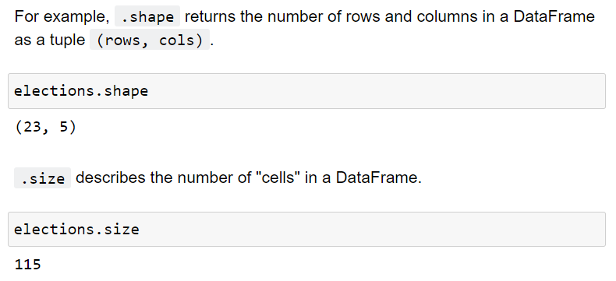
Utility Methods
.shape
.size

Slide 87
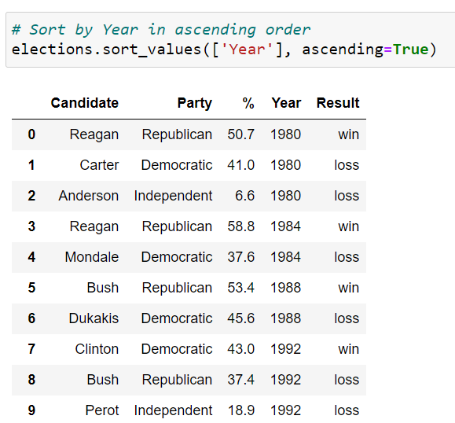
Utility Methods
.sort_values()

Slide 88
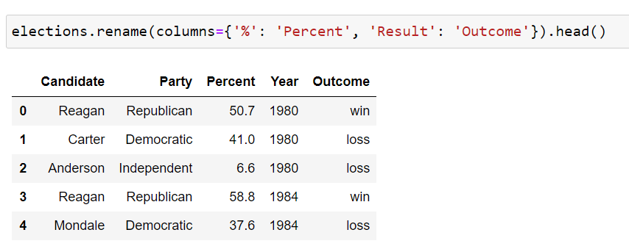
Utility Methods
.rename()

Slide 89
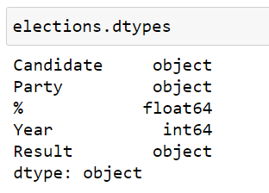
Utility Methods
.dtypes

Slide 90
Utility Methods
.describe()
.info()
.unique()
.value_count()
.astype()
Many, many, many more.

Slide 91
Practice!
Launch the Lecture 2.1 notebook from Quercus and review the material from this lecture in more detail.
Link

Slide 92
installing third-party packages, managing environments, and Pandas.
Week 12 | Lecture 1 (12.1)

